Slide 1
Do What You Do Best and
Outsource the Rest
Notes:
Nicole’s introduction - Hi I’m NTML. Our customers outsource their math teaching to us.
I’m also a homeschool mom. When I first started homeschooling, I tried to do everything all myself. I teach math and reading. I have built a team and I manage them to teach reading comprehension/grammar, social studies, science, and coding.
Katie’s introduction

Slide 3
Who’s Here?
First-timers
2nd/3rd year
4+ years

Slide 4
Step 1
Give yourself permission to not do it all

Slide 5
I am my child’s best teacher.
Notes:
Discuss pros/cons of this statement with your partner. Debrief

Slide 6
I manage my homeschool and I’m one of my child’s awesome teachers.
I am my child’s best teacher.

Slide 7
Step 2
Build the Right Team

Slide 8
Building Your Team
What do
I want?
Notes:
What are the characteristics you are looking for?

Slide 9
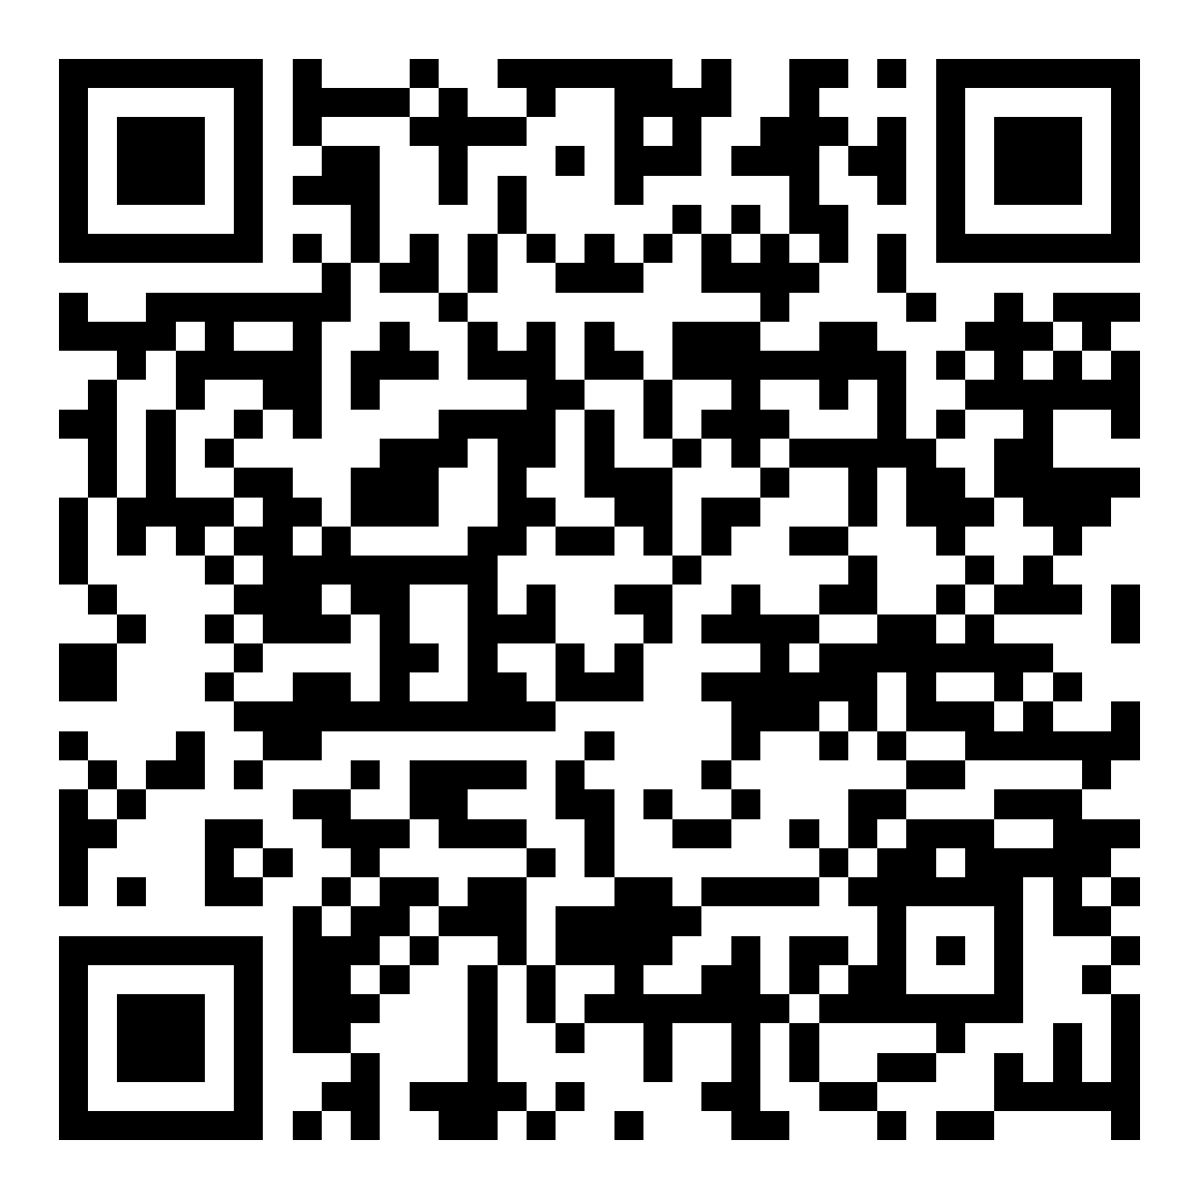
Homeschooling styles
Notes:
Understanding your style - so you know what you’re looking for
Either someone in the style you prefer or be open to other styles.

Slide 10
Learning Environments
Group size
 | One-on-one | Small Group | Large Group
In-Person
Virtual Real Time
Virtual On-Demand
Location

Slide 11
Learning Environments
David - Math
Group size
 | One-on-one | Small Group | Large Group
In-Person
Virtual Real Time
Virtual On-Demand
Location
Notes:
Have them select a student/subject

Slide 12
Learning Environments
David - Spanish
Group size
 | One-on-one | Small Group | Large Group
In-Person
Virtual Real Time
Virtual On-Demand
Location

Slide 13
Instructor qualities
Education
Experience
Student Engagement Methods
Communication Skills
Accessibility

Slide 14
PRICE
Notes:
We’ve heard from parents that money can be a reason that stops people from building a team. How many of you have a concern about money?
You may have to spend some money.
But we’re here to let you know that not everything costs a lot of money.
There are free/lower cost resources that are great.
Also just because it costs a lot of $$; doesn’t mean it’s automatically better/good.

Slide 15
WHAT do I Want
Subject | Homeschooling Style | Learning Environment | Instructor Qualities | Price
Grammar | Eclectic | One-on-one/ In-person | Gentle, High communication, Engaging in various ways | $$$
Piano Practice | Unschooling/Montessori | One-one-one/In-person/virtual | Fun | Free

Slide 16
Building Your Team
What do
I want?
Where can
I find it?
Notes:
What are the characteristics you are looking for?

Slide 17
Where to find help
Category | Example
Family | Mom - Piano/Read a Book
Fellow Homeschooler (Swap) | Heather - Literacy/PE
Class/Co-op/Hybrid Program | Hybrid - SS/Science/Art
Students | Nina - Science Project
Teacher/Tutor | Ms. Jenny/ELA
Programs/Platforms

Slide 18
Educational Platforms
Virtual
School
Easy Peasy

Slide 19
Where to find help
Category | Example
Family | Mom - Piano/Read a Book
Fellow Homeschooler (Swap) | Heather - Literacy/PE
School/Co-op/Hybrid Program | Hybrid - SS/Science/Art
Students | Nina - Science/ Teaching Programs
Teacher/Tutor | Ms. Jenny/ELA and Art Class
Educational Platforms | NTML - Math
Clubs/Camps | Coding/4-H/Library/Rec Centers
Internships/Apprenticeships | Museum/Zoo
Notes:
Have them work with a partner.

Slide 20
Building Your Team
How do
I know if
it’s a fit?
What do
I want?
Where can
I find it?
Notes:
What are the characteristics you are looking for?

Slide 21
Do a Trial
Notes:
Teacher who came to my house

Slide 22
Step 3
Monitor and Evaluate

Slide 24
HOW TO AVOID THINGS
GOING WRONG
Pay attention to warning signs
Trust your gut
Communicate

Slide 25
Check on progress
Ask Your Student
Observe/Listen in on a Session
Have a Teacher Conference (In-person/Zoom)
Ask for Formal/Informal Assessments

Slide 26
Acknowledge
your team
What Worked?
What Didn’t?
Make Decisions for Next Year

Slide 27
Videos
Automated Online Grading
Tools to Close Gaps (One-Minute Tutorials & Mastery Bank)
Starts at $59 a year for single student/$99 a year for a family

Slide 29
https://singapore.nicolethemathlady.com/

Slide 30
Learn Addition & Subtraction Math Facts in 60 days
Learn Multiplication & Division Facts in 90 days
Starts at $21.99 for single student

Slide 32
nicolethemathlady.com/workshops
nicolethemathlady.com/expansion

