Slide 1
MATH GAPS:
How to find them and fill them up

Slide 2
What is a math gap?
A math learning gap refers to any math skill that a student should have previously mastered, but didn’t.

Slide 3
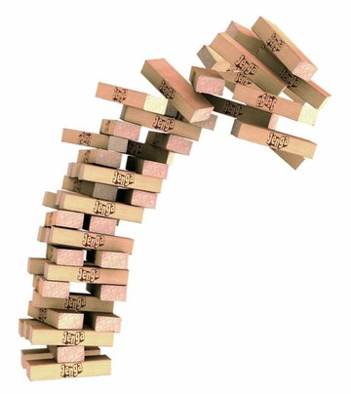
Why are math gaps a problem?

Slide 4
The nature of math
Calculus
Trigonometry
Exponential Algebra
Geometry
Linear Algebra
Pre-Algebra
Arithmetic

Slide 5
Where do we need multiplication?
Factors/Greatest Common Factor
Multiples/Least Common Multiple
Common denominator
Simplifying Fractions
Converting Mixed Numbers to Improper Fractions
Equivalent Fractions
Multiplying Fractions
Dividing Fractions Roots
Measurement Conversions
Decimals
Proportions
Percents
Rates
Exponents and Square Roots
Measurement Conversions

Slide 7
What’s Missing?
Automaticity
Fluency

Slide 8
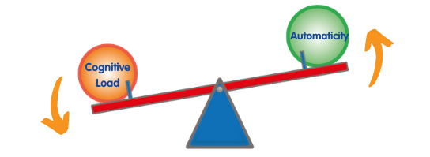
Automaticity
Automaticity is the ability to deliver a correct answer immediately from memory without conscious thought, as opposed to relying on calculation.
- Stickney et al. (2012)
Automaticity
Cognitive
Load

Slide 9
Fluency
Gets correct answer
Completes step accurately
Applies strategy to a new problem type
Solve in a reasonable amount of time
Select the appropriate strategy

Slide 10
So what’s the problem?
Without automaticity in math facts and math fact families, it will be more difficult for students to engage in the higher order thinking skills that are necessary to solve many math problems.

Slide 11
Best way to handle math gaps

Slide 12
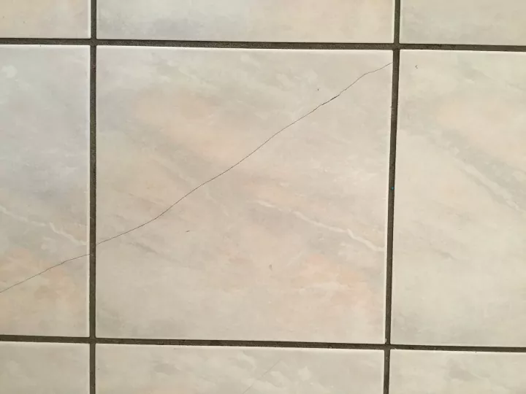

Slide 13
them as they
are forming

Slide 14
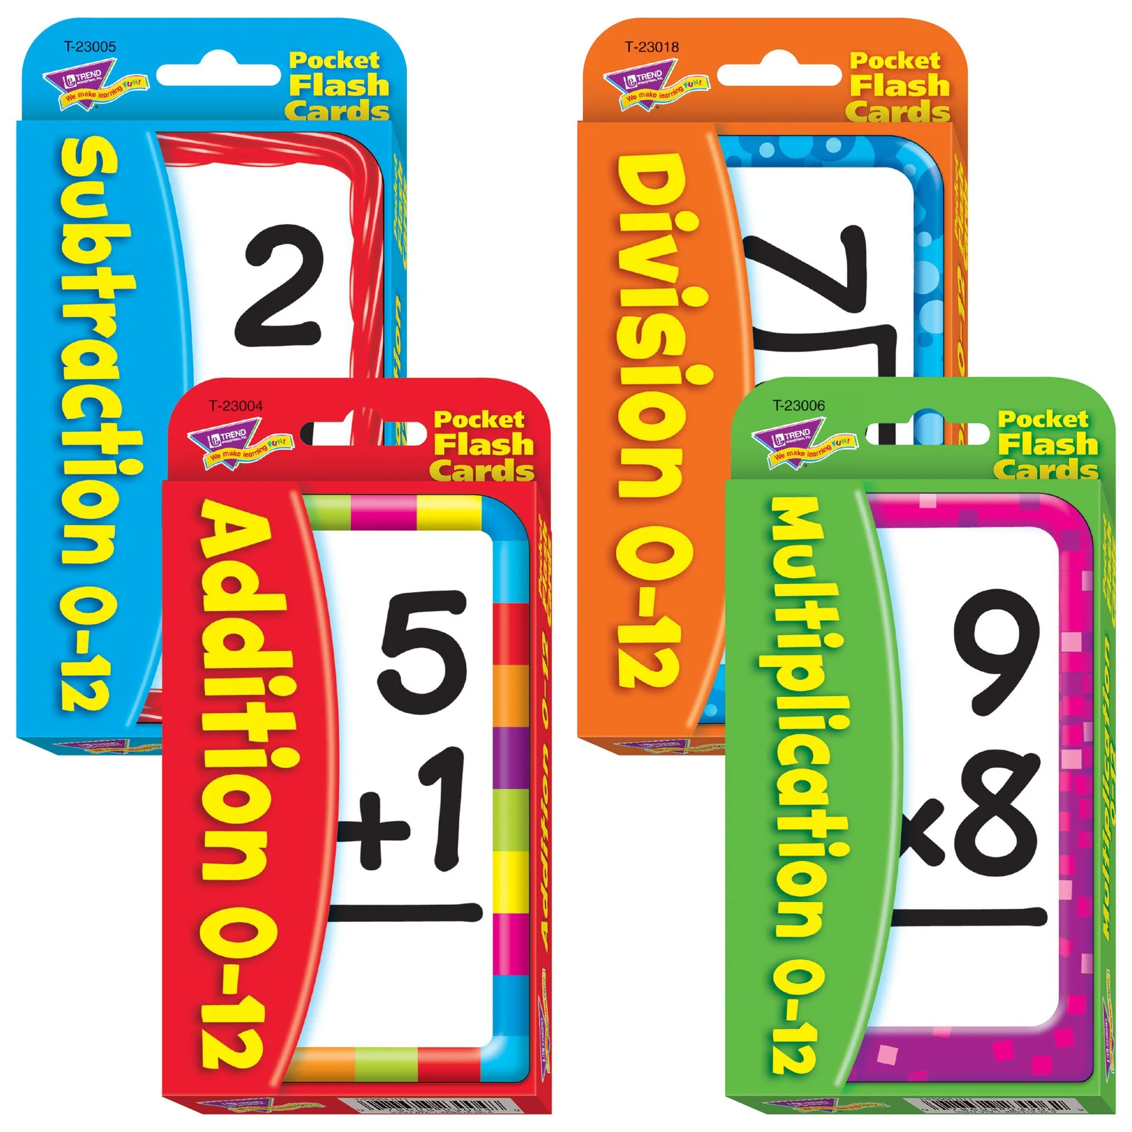
Where do math gaps occur?

Slide 15
Which method works?
Skip counting
Stories
Songs
Drills

Slide 16
The research shows….
So find something your kids will enjoy!

Slide 18
It’s not the what, it’s the HOW!

Slide 20
We need intentional, targeted practice to reinforce these foundations and fill the math gaps.

Slide 21
Automaticity in math facts requires…

Slide 22
Dedicate Time

Slide 25
Dedicate Time
Easy Ones First

Slide 26
Recommended order for Teaching Addition Facts
Doubles (Dark Orange)
Sums of 10 (Dark Green)
10 Plus (Dark Blue)
Plus 0 (Dark Purple)

Slide 27
Recommended order for Teaching Multiplication Facts
Times 0 (Dark Purple)
Times 1 (Dark Purple)
Times 2 (Dark Green)
Times 10 (Dark Red)

Slide 28
Dedicate Time
Easy Ones First
Slow and Steady Wins the Race

Slide 29
Teach three at a time

Slide 30
Dedicate Time
Easy Ones First
Slow and Steady Wins the Race
Interesting (FUN!)

Slide 32
How do you fix gaps in ?

Slide 33
Filling Pre-algebra gaps
Do it in context
Practice
Reteach
Find the gap

Slide 34
5
2
2
3
4
5

Slide 35
5
2
4
2
3
5

Slide 36
30
4
5
2
10
+20
Step 1: Find a common denominator
=
4
20
Step 2: Make equivalent fractions
2
3
12
=
5
20
Step 3: Regroup
2
Step 4: Subtract mixed numbers
18
20
Step 5: Simplify
2
9
18
÷
=
2
2
10
20
9
2
10

Slide 37
Should I change my math curriculum?

Slide 38
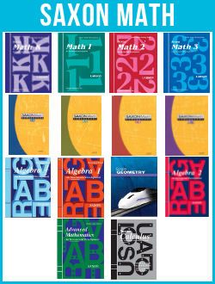
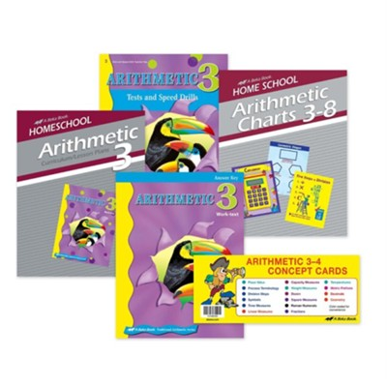
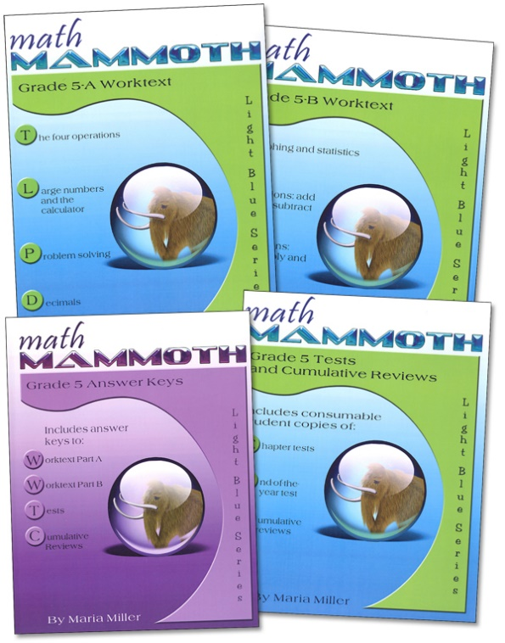
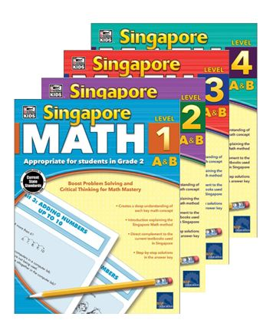
Notes:
How has choosing math curriculums been for you.
It can be overwhelming. There’s so many to choose from:
Saxon Math
Singapore Math
BJU Press
Horizons
Math You See
Abeka
Math Mammoth
Life of Fred
Do you have any idea how many math curriculums homeschoolers have to choose from?

Slide 39
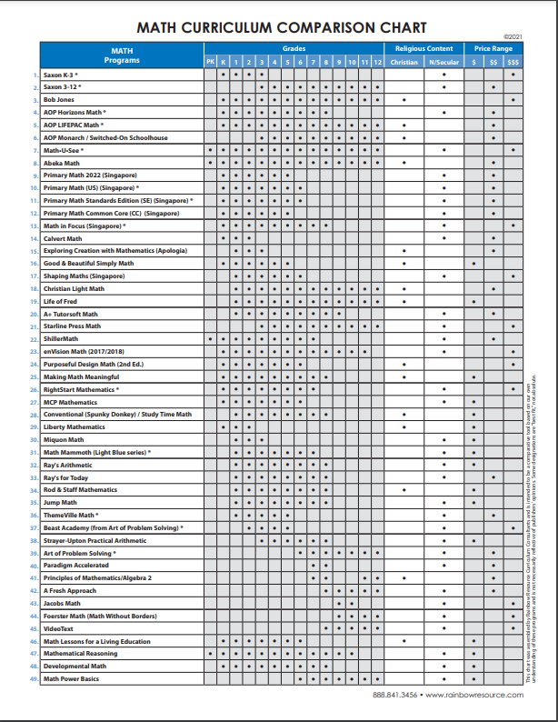
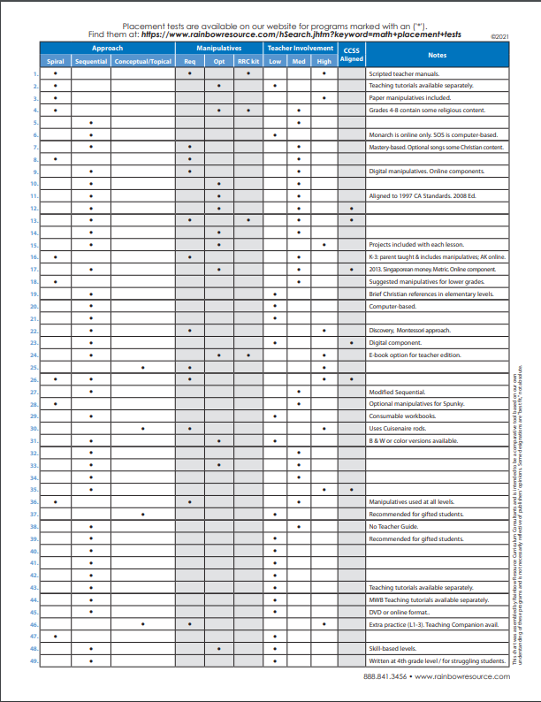
Rainbow Resource
Math Comparison Chart

Slide 40
Rainbow Resource
Math Comparison Chart

Slide 46
Learn Addition & Subtraction Math Facts in 60 days
Learn Multiplication & Division Facts in 90 days
$21.99 for a single student
Signup at Conference - Free Adventure Kit

Slide 47
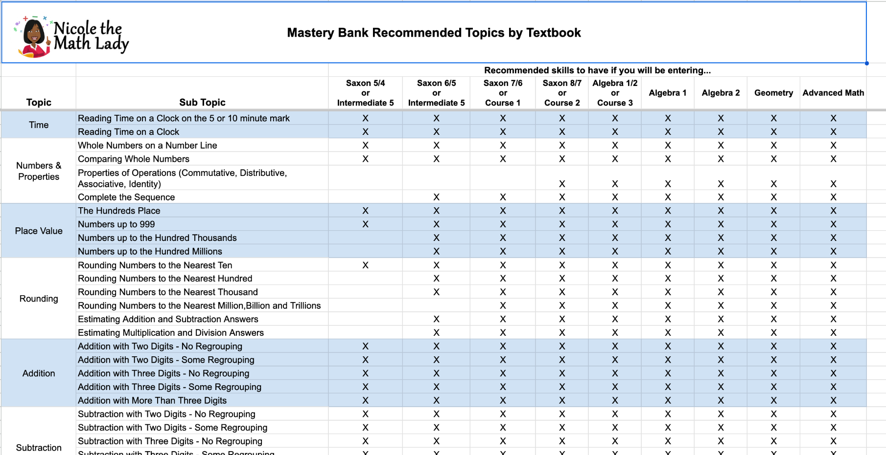

Slide 48
nicolethemathlady.com/workshops

