Slide 1
You Mean My Kids Can Actually Love (and Do Well in) Math?
Notes:
About Me – NTML
Justin - Homeschooler
How many of you loved math? Favorite subject? Why?
How many of you hated math? Why?

Slide 2
It
Sticky!
Make

Slide 3
Manipulatives

Slide 4
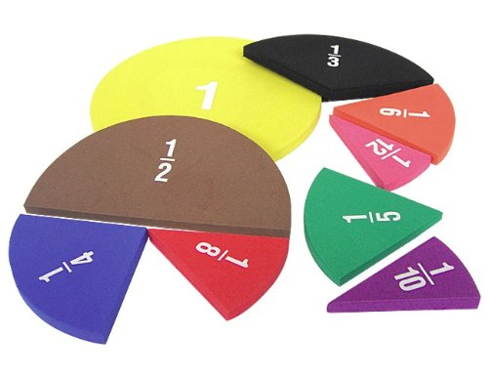

Slide 5
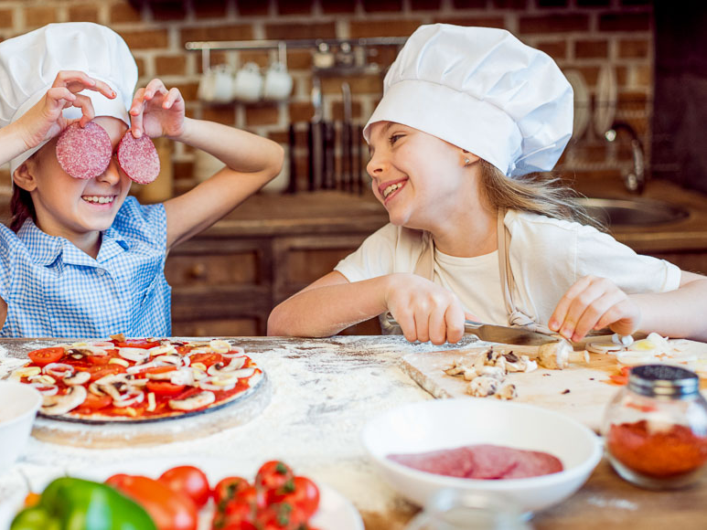

Slide 6
1 -
3
8

Slide 7
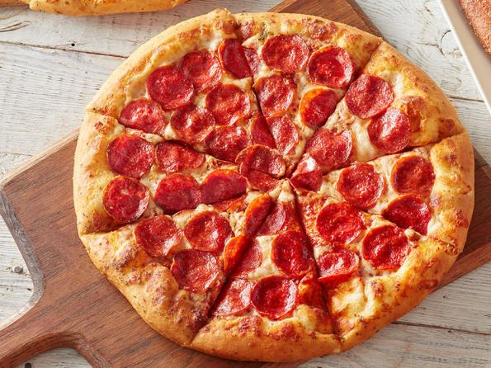

Slide 8
1 -
3
8
-
8
8
3
8
5
8
=

Slide 9
Word Problems
In the four containers, there are 17 crayons, 7 crayons, 11 crayons and 5 crayons. If the crayons were rearranged so that each container had the same number of crayons, how many crayons would be in each container?

Slide 10
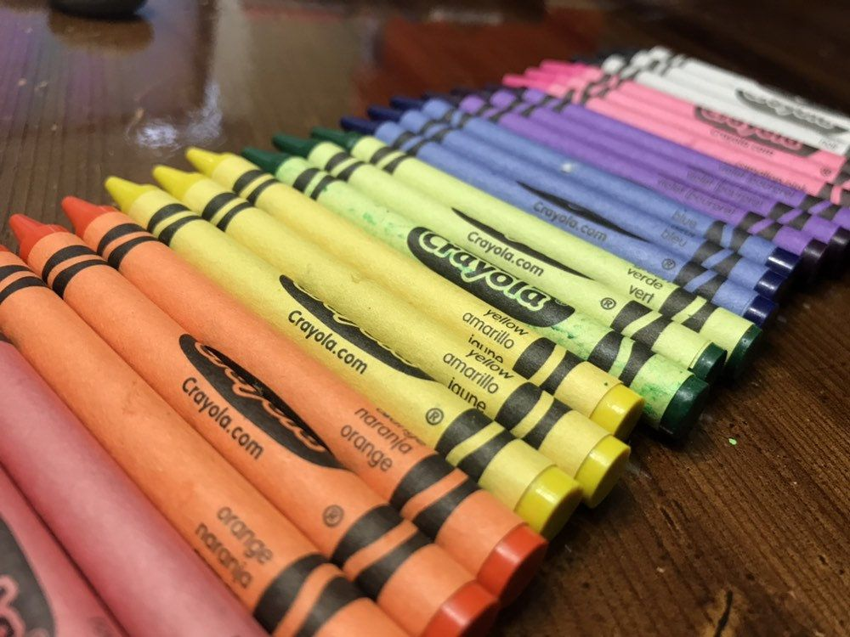
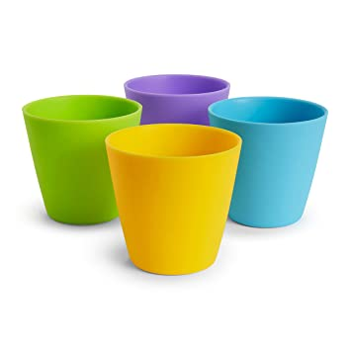

Slide 11
Manipulatives
Movement

Slide 12
y
Plot (3,2)
4
3
2
1
Plot (-5,-2)
(3,2)
0
x
-5 -4 -3 -2 -1
1 2 3 4 5
-1
-2
-3
-4
(-5,-2)

Slide 13
Manipulatives
Activity
Movement

Slide 14
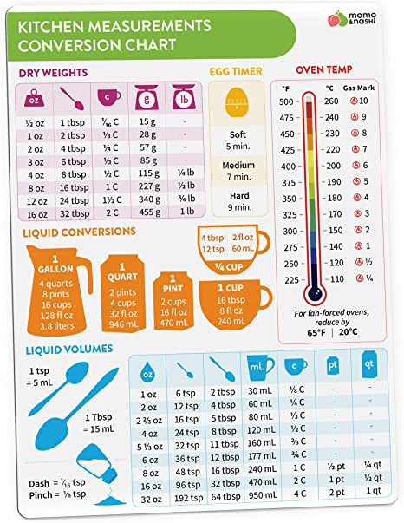

Slide 15
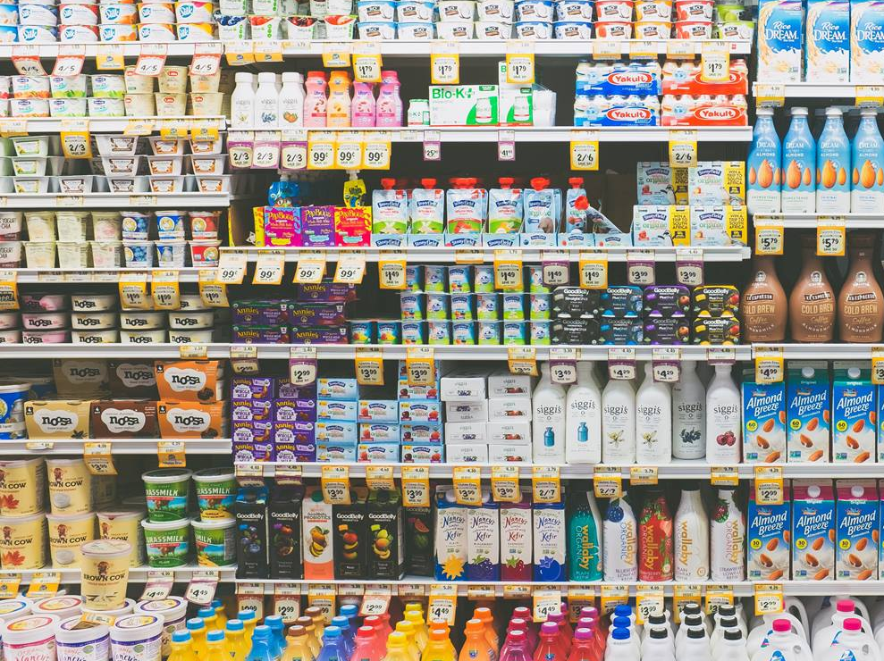
Let’s go on a Scavenger Hunt!
Notes:
About Me – NTML
Justin - Homeschooler
How many of you loved math? Favorite subject? Why?
How many of you hated math? Why?

Slide 16
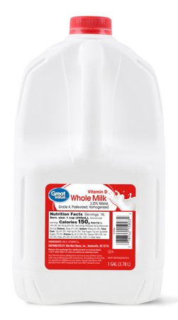
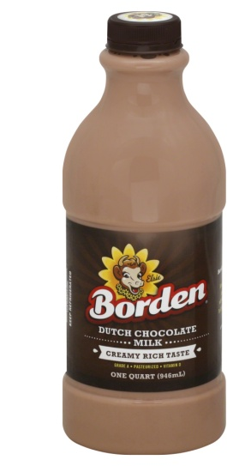
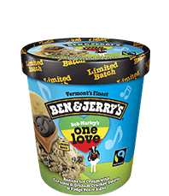
cup
pint
quart
½ gallon
gallon

Slide 17
Liquid Measurement
How many cups are in a quart?
How many pints are in a gallon?
How many cups are in a gallon?
Cup
Pint
Quart
Half Gallon
Gallon
2
2 x 2 = 4
2 x 2 x 2 = 8
2 x 2 x 2 x 2 = 16
2
2
2

Slide 18
Manipulatives
Activity
Movement
Music

Slide 19
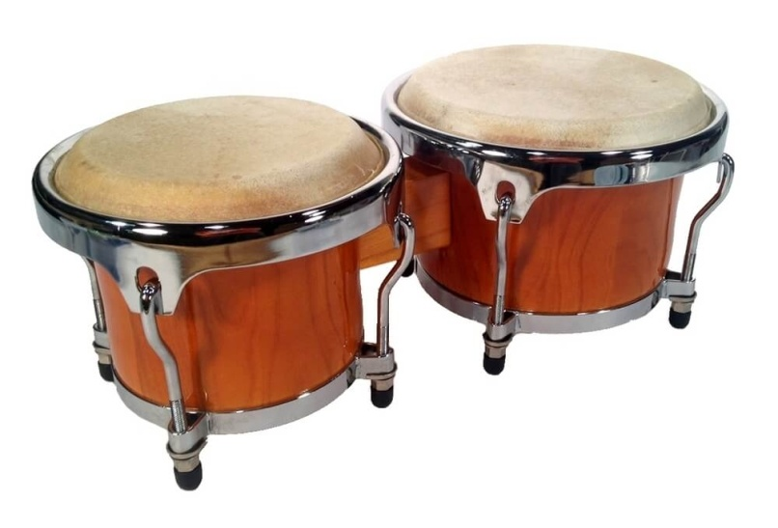
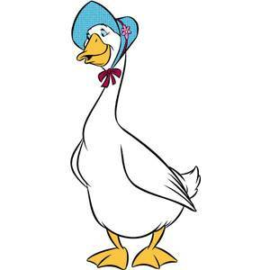
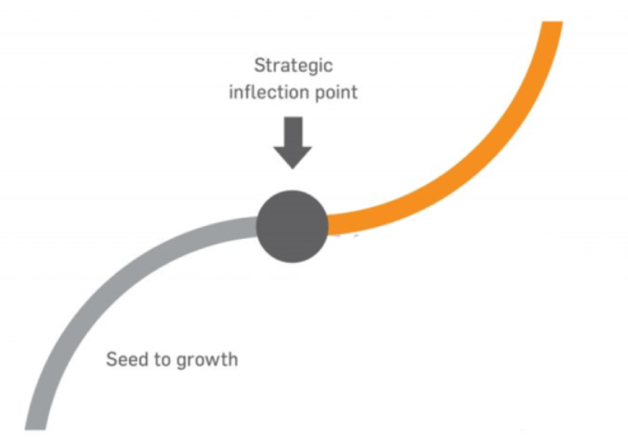
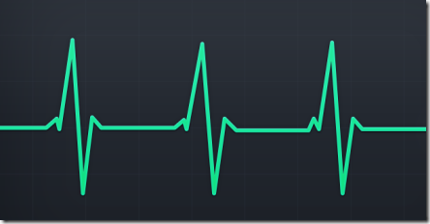
Rhythm
Rhyming
Inflection
Repetition

Slide 21
But this is America…you have to be fair!
What’s the name of the game?
How do you get X by itself?
To get x by itself
Do the opposite
What you do to one side,
you have to do to the other

Slide 22
Let’s Learn Algebra
2x + 4 = 10
-4
-4 -4
= 6
2x
2
2
x
= 3

Slide 23
Let’s Learn Algebra
5x - 6 = 19
+6 -4
+6
= 25
5x
5
5
x
= 5

Slide 24
Manipulatives
Activity
Movement
Build on
the Basics
Music

Slide 26
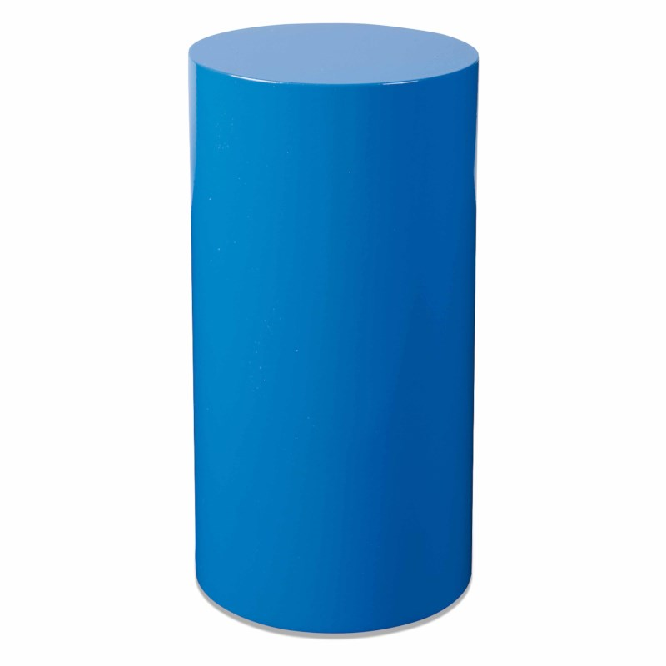
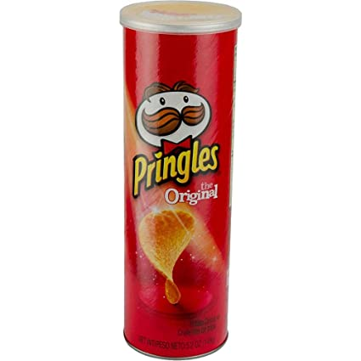
Notes:
About Me – NTML
Justin - Homeschooler
How many of you loved math? Favorite subject? Why?
How many of you hated math? Why?

Slide 27
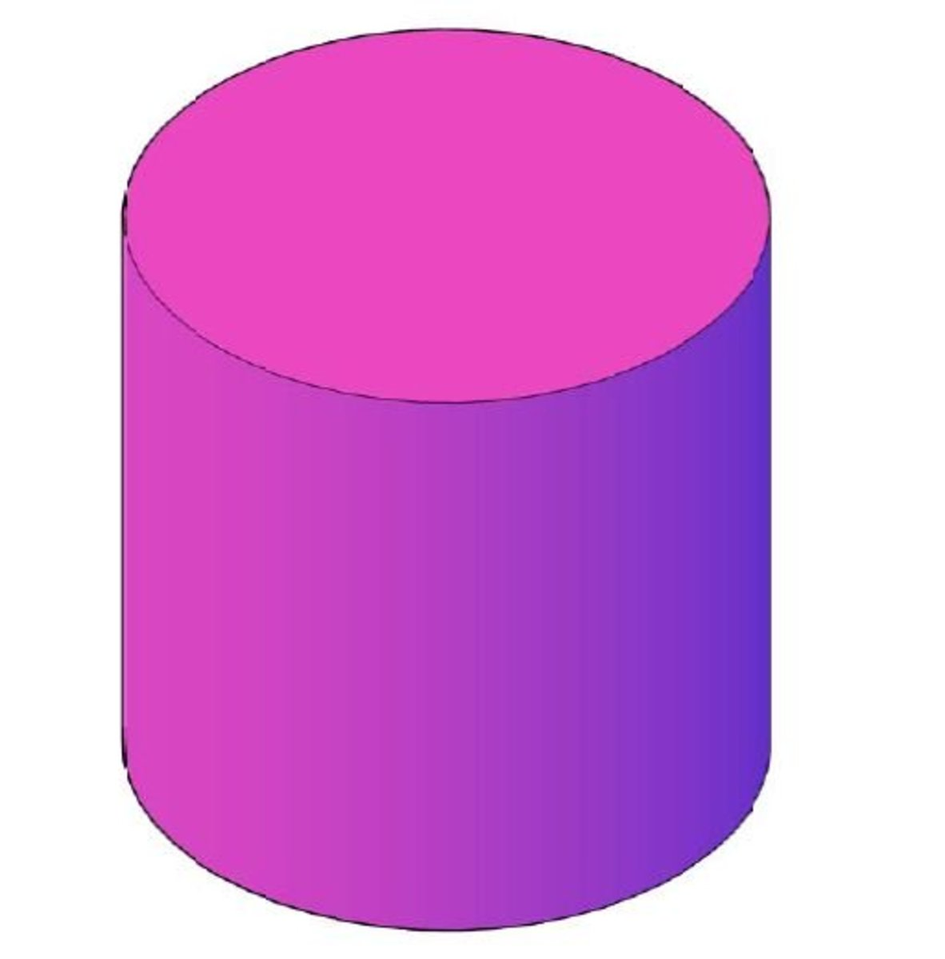
Finding Volume
π
A = r²
Volume = Area of the Base x height
V = r²h
π

Slide 28
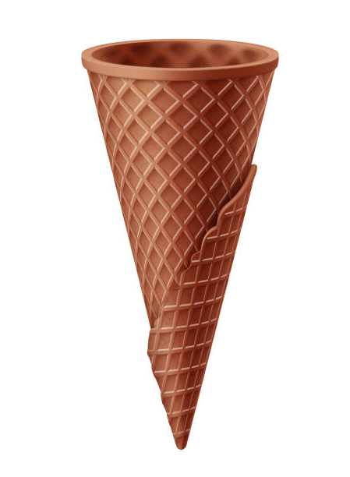
Notes:
About Me – NTML
Justin - Homeschooler
How many of you loved math? Favorite subject? Why?
How many of you hated math? Why?

Slide 29
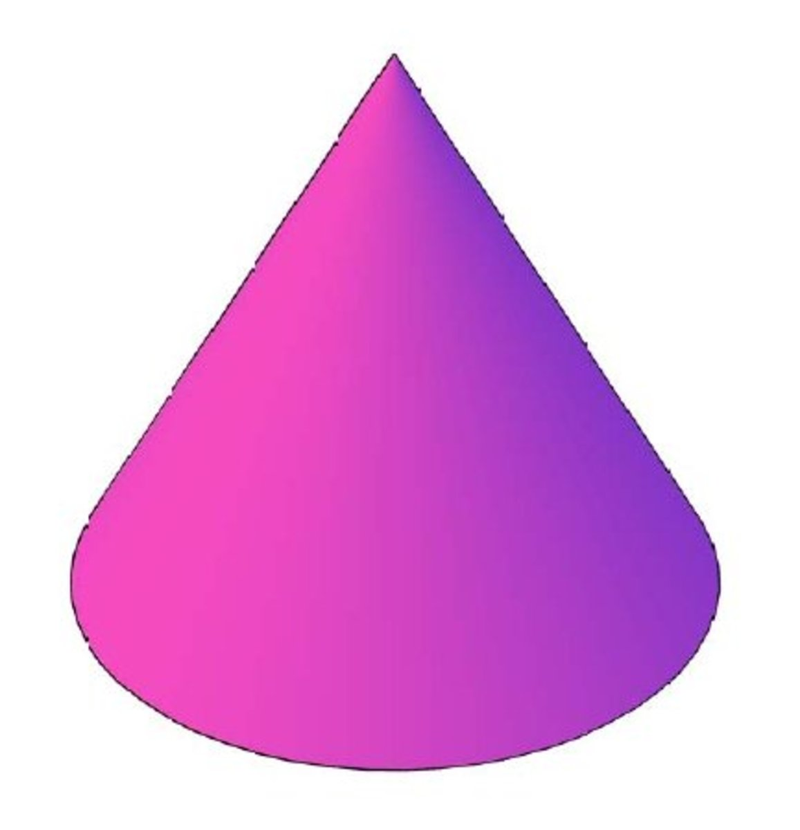
Finding Volume
π
A = r²
1
3
π
V = r²h

Slide 30
Manipulatives
Activity
Movement
Mneumonics
Build on
the Basics
Music

Slide 31
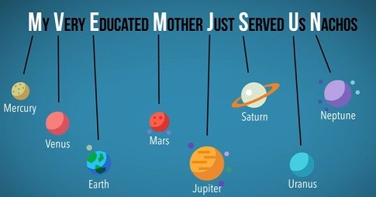

Slide 32
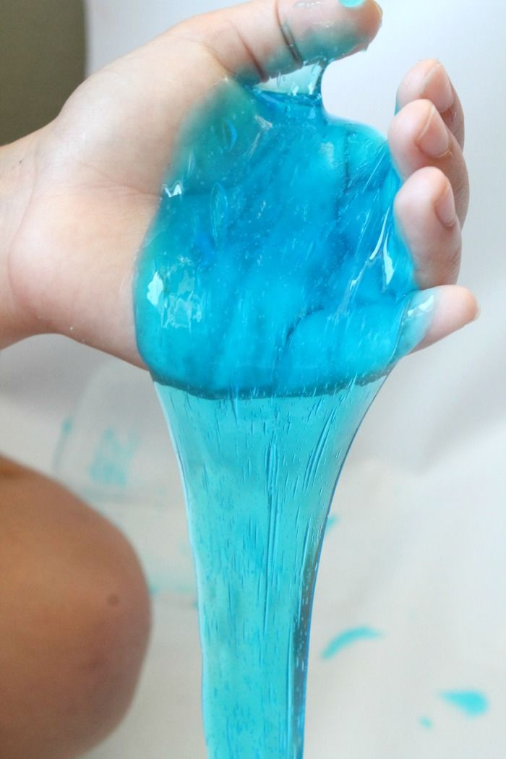
X
Divide
Multiply
Subtract
Bring Down

Slide 33
X
Don’t
Make
Slime
Blue

Slide 34
1
2
5
5)625
5
1
2
10
2
5
25
0

Slide 35
3 Common Mistakes
Parents Make

Slide 36
The Momentum Musher

Slide 37
The Explainerator

Slide 38
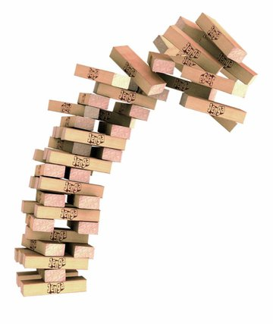
The Tower Tumbler

Slide 39
Do What You Do Best and
Outsource the Rest!

Slide 40
Videos
Automated Online Grading
Tools to Close Gaps (One-Minute Tutorials & Mastery Bank)
Starts at $59 a year for single student/$99 a year for a family

Slide 42
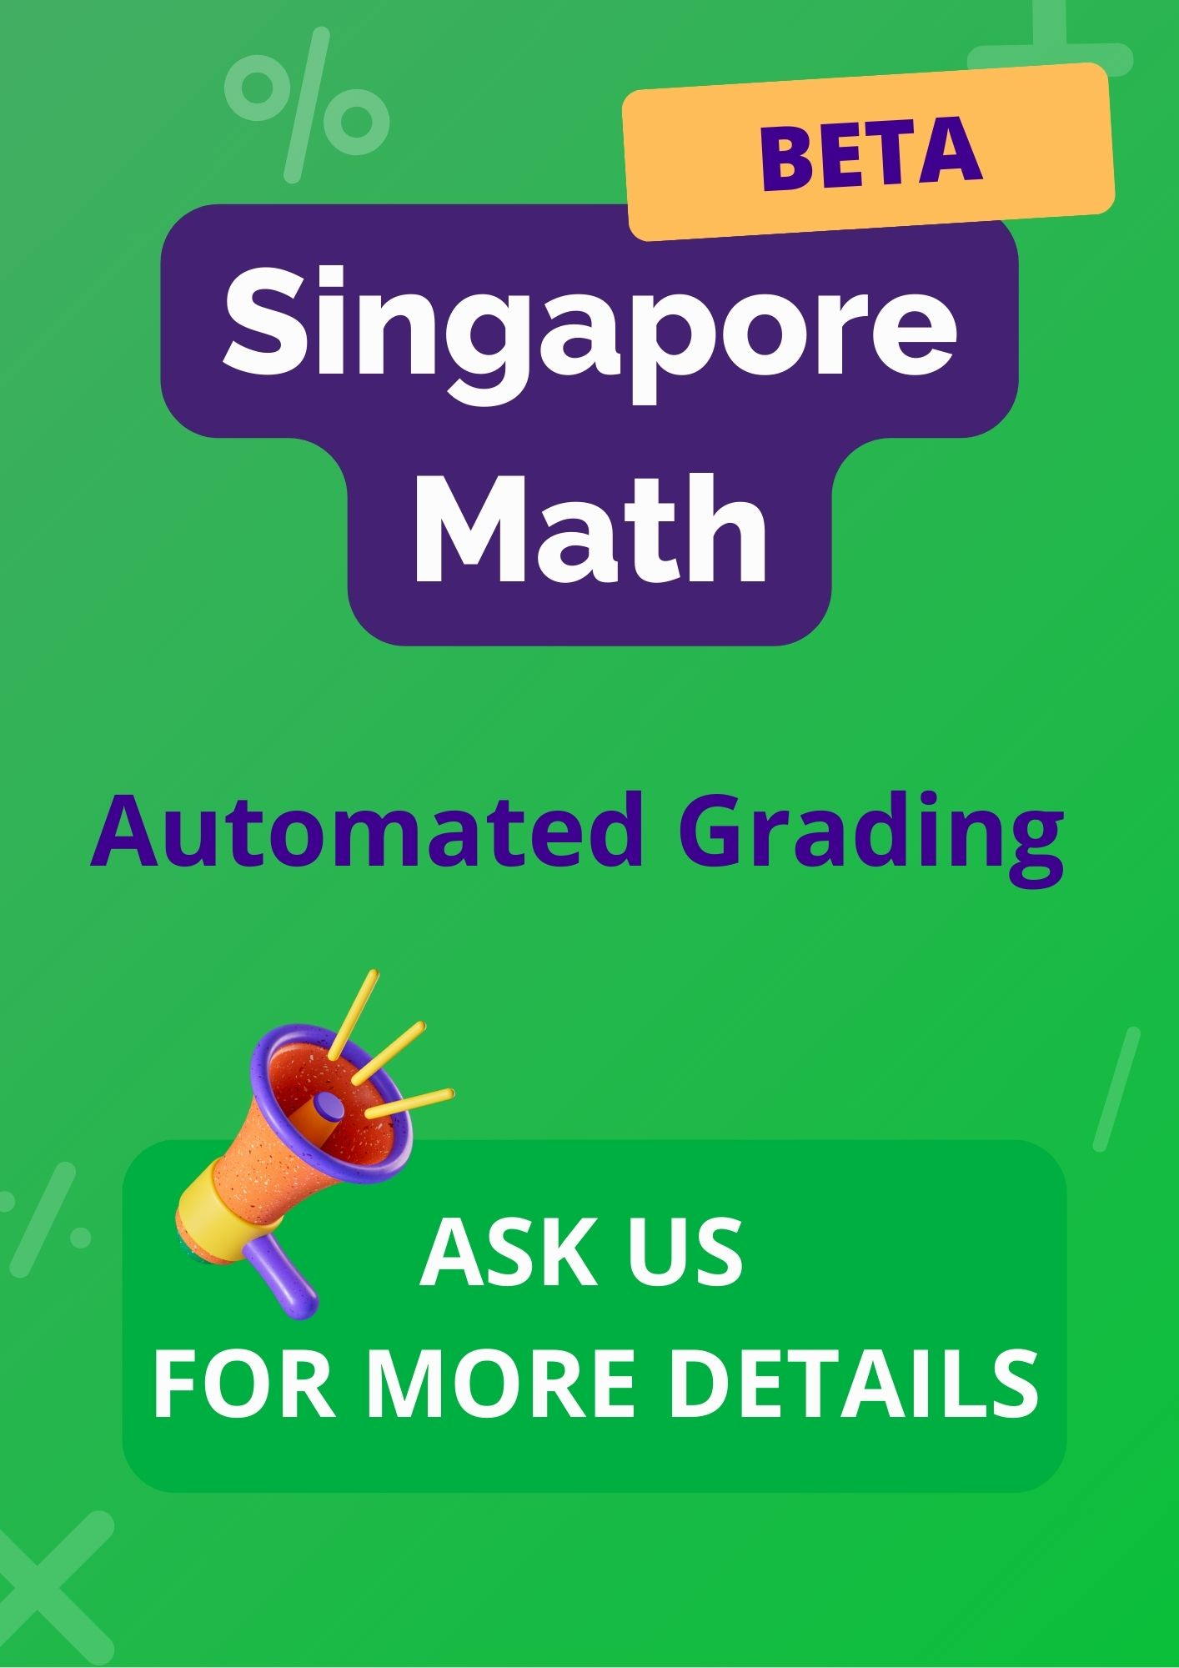
https://singapore.nicolethemathlady.com/

Slide 43
Learn Addition & Subtraction Math Facts in 60 days
Learn Multiplication & Division Facts in 90 days
$21.99 for a single student

Slide 45
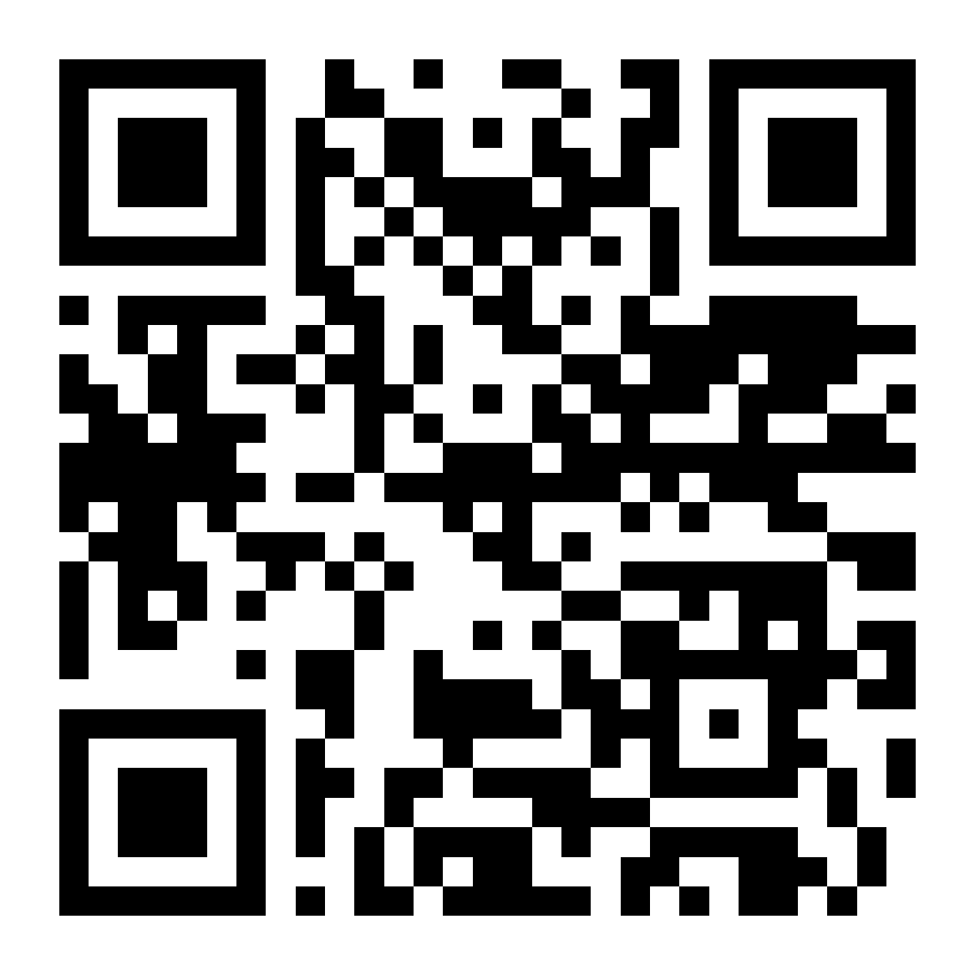
nicolethemathlady.com/workshops

